Slide 1
PAL Session 8

Slide 2
Getting Started​
Do you have a job? If yes, what is?​
What do you prefer online classes or in person?

Slide 3
Objectives / Content
Chapter 4
Principles of counting and rules of addition

Slide 4
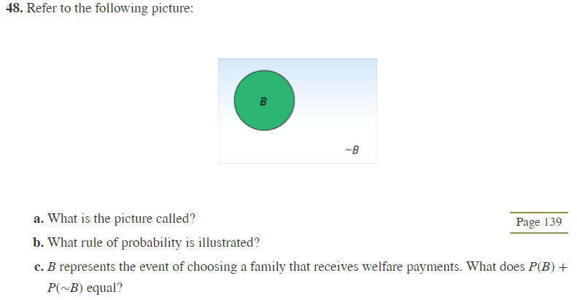
Anwers
A) Venn Chart (Definition)
B) The Complement Rule (Definition)
C) 1
Practice

Slide 5

Answers)
[26]*[26]*[26]*[26] = 26^4
Practice

Slide 6
Answers)
[4] * [4] * [4] * [4] = 4^4 = 16
Practice)

Slide 7
Answer)
If I get a 1,2,3,4,5,6,7 or 7,6,5,4,3,2,1, well the other does not matter, so we will use combination
C(52,7) = 133784560
Practice4560

Slide 8
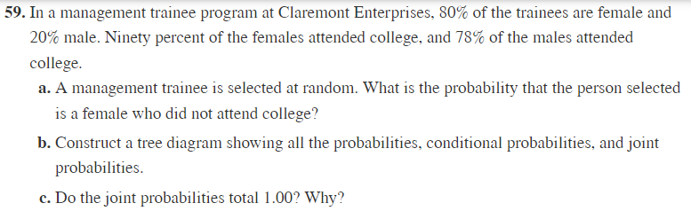
Answer)
a) 0.8 * (1-0.9) = 0.08
b) Next slide
c) Yes, because all the possible outcomes are presented in the diagram
Practice)

Slide 9
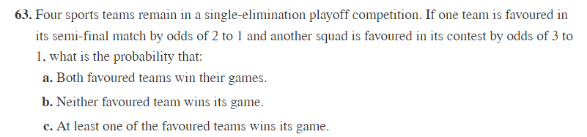
Answer)
A - 2 to 1 means, 2 wins for 1 loss. So the probability to win is number of winnings divide by number of games. So 2/3. In the same way, 3 to 1 means 3/4 . So the probability is 2/3*3/4 = 1/2
B - (1 – 1/3)/(1-3/4) = 1/12
C - Two ways:
1) 2/3 + 3/4 – 1/2 = 11/12
Prob Team A win + Prob Team B win – Prob Team A and B win
2) If the probability of neither one win is 1/12, 1 – 1/12 is the probability that at least one will win
Practice)

Slide 10
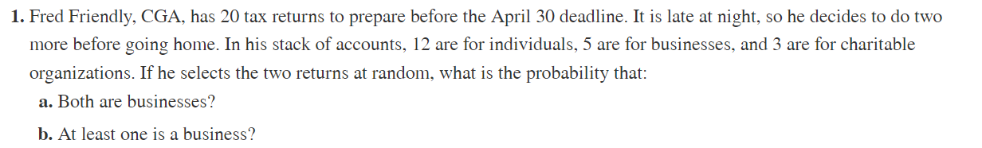
Practice:
A)
B)
Answers:
a) 5/20 * 4/19 = 1/19
B) All possible events – Probability of getting either
= 1 - (15/20)*(14/19) = 0.4474

Slide 11
Practice:
Answer:
P(jog) = 0.3
P(ride) = 0.2
P(ride and jog) = 0.12
P(jog) + P(ride) - P(ride and jog) = 0.3 + 0.2 - 0.12 = 0.38

Slide 12
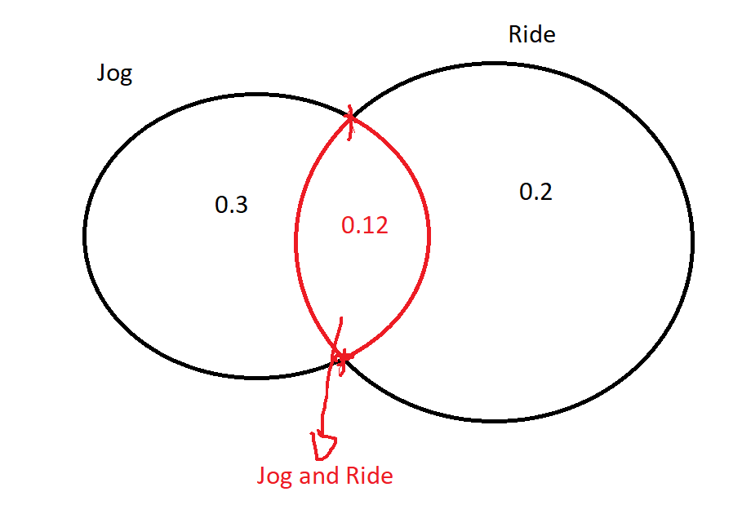

Slide 13
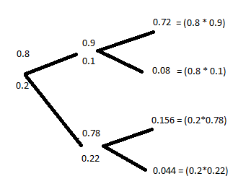
Skip this. It is for next Class

Slide 14
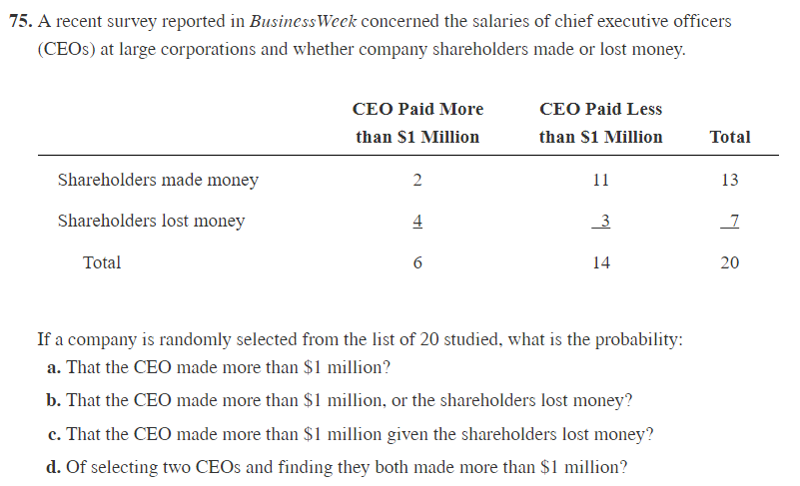
Answer
6/20
6/20 + 7/20 – 4/20
4/7
6/20*5/19
Practice

Slide 15
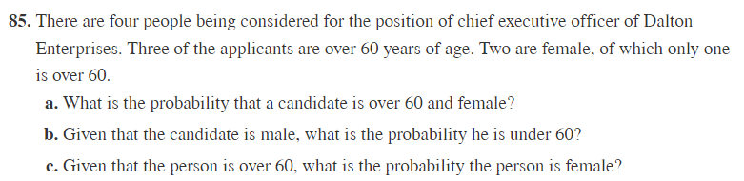

Slide 16
 | Over 60 | Not over 60 | Total
Male | 2 | 0 = 2 + 1 + 1 - 4 | 2
Female | 1 | 1 = (2 – 1) | 2
Total | 3 | 1 | 4
Answers)
1/4
0
c) 1/3

